Slide 1

Team 23 Final Project Presentation- Cryptography

Slide 2
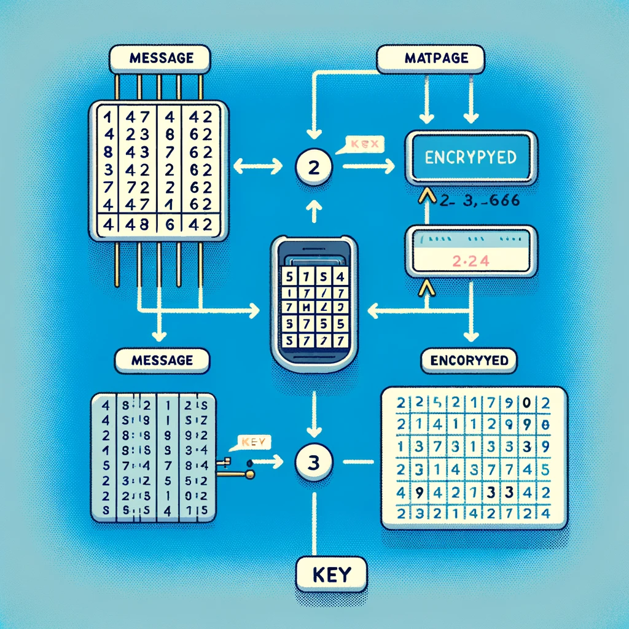

Overview
Background
Cryptography in Engineering
Example of Encryption
Example of Decryption
Modern Encryption
Other Examples of Encryption
Conclusion
Notes:
Adrian

Slide 3
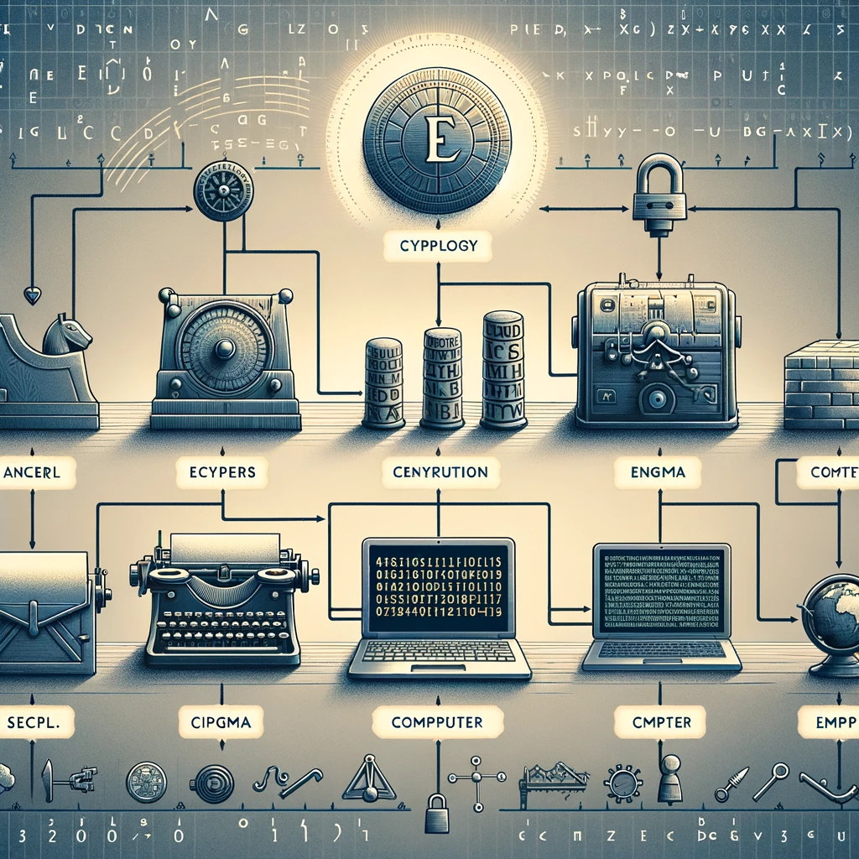
Background
Cryptology: A Brief Overview
Foundation of secure communication.
Encompasses cryptography (code creation) & cryptanalysis (code breaking).
Evolution of Cryptography
Ancient times: Simple substitution ciphers.
Modern era: Complex algorithms & computerized encryption.
Hill Cipher Introduction:
Developed by Lester S. Hill in 1929
First polygraphic (encrypts multiple letters at a time) cipher directly using linear algebra.
The Role of Matrices:
Encryption & Decryption using matrix operations.
Key: An invertible matrix in linear algebra.
Notes:
Adrian

Slide 4

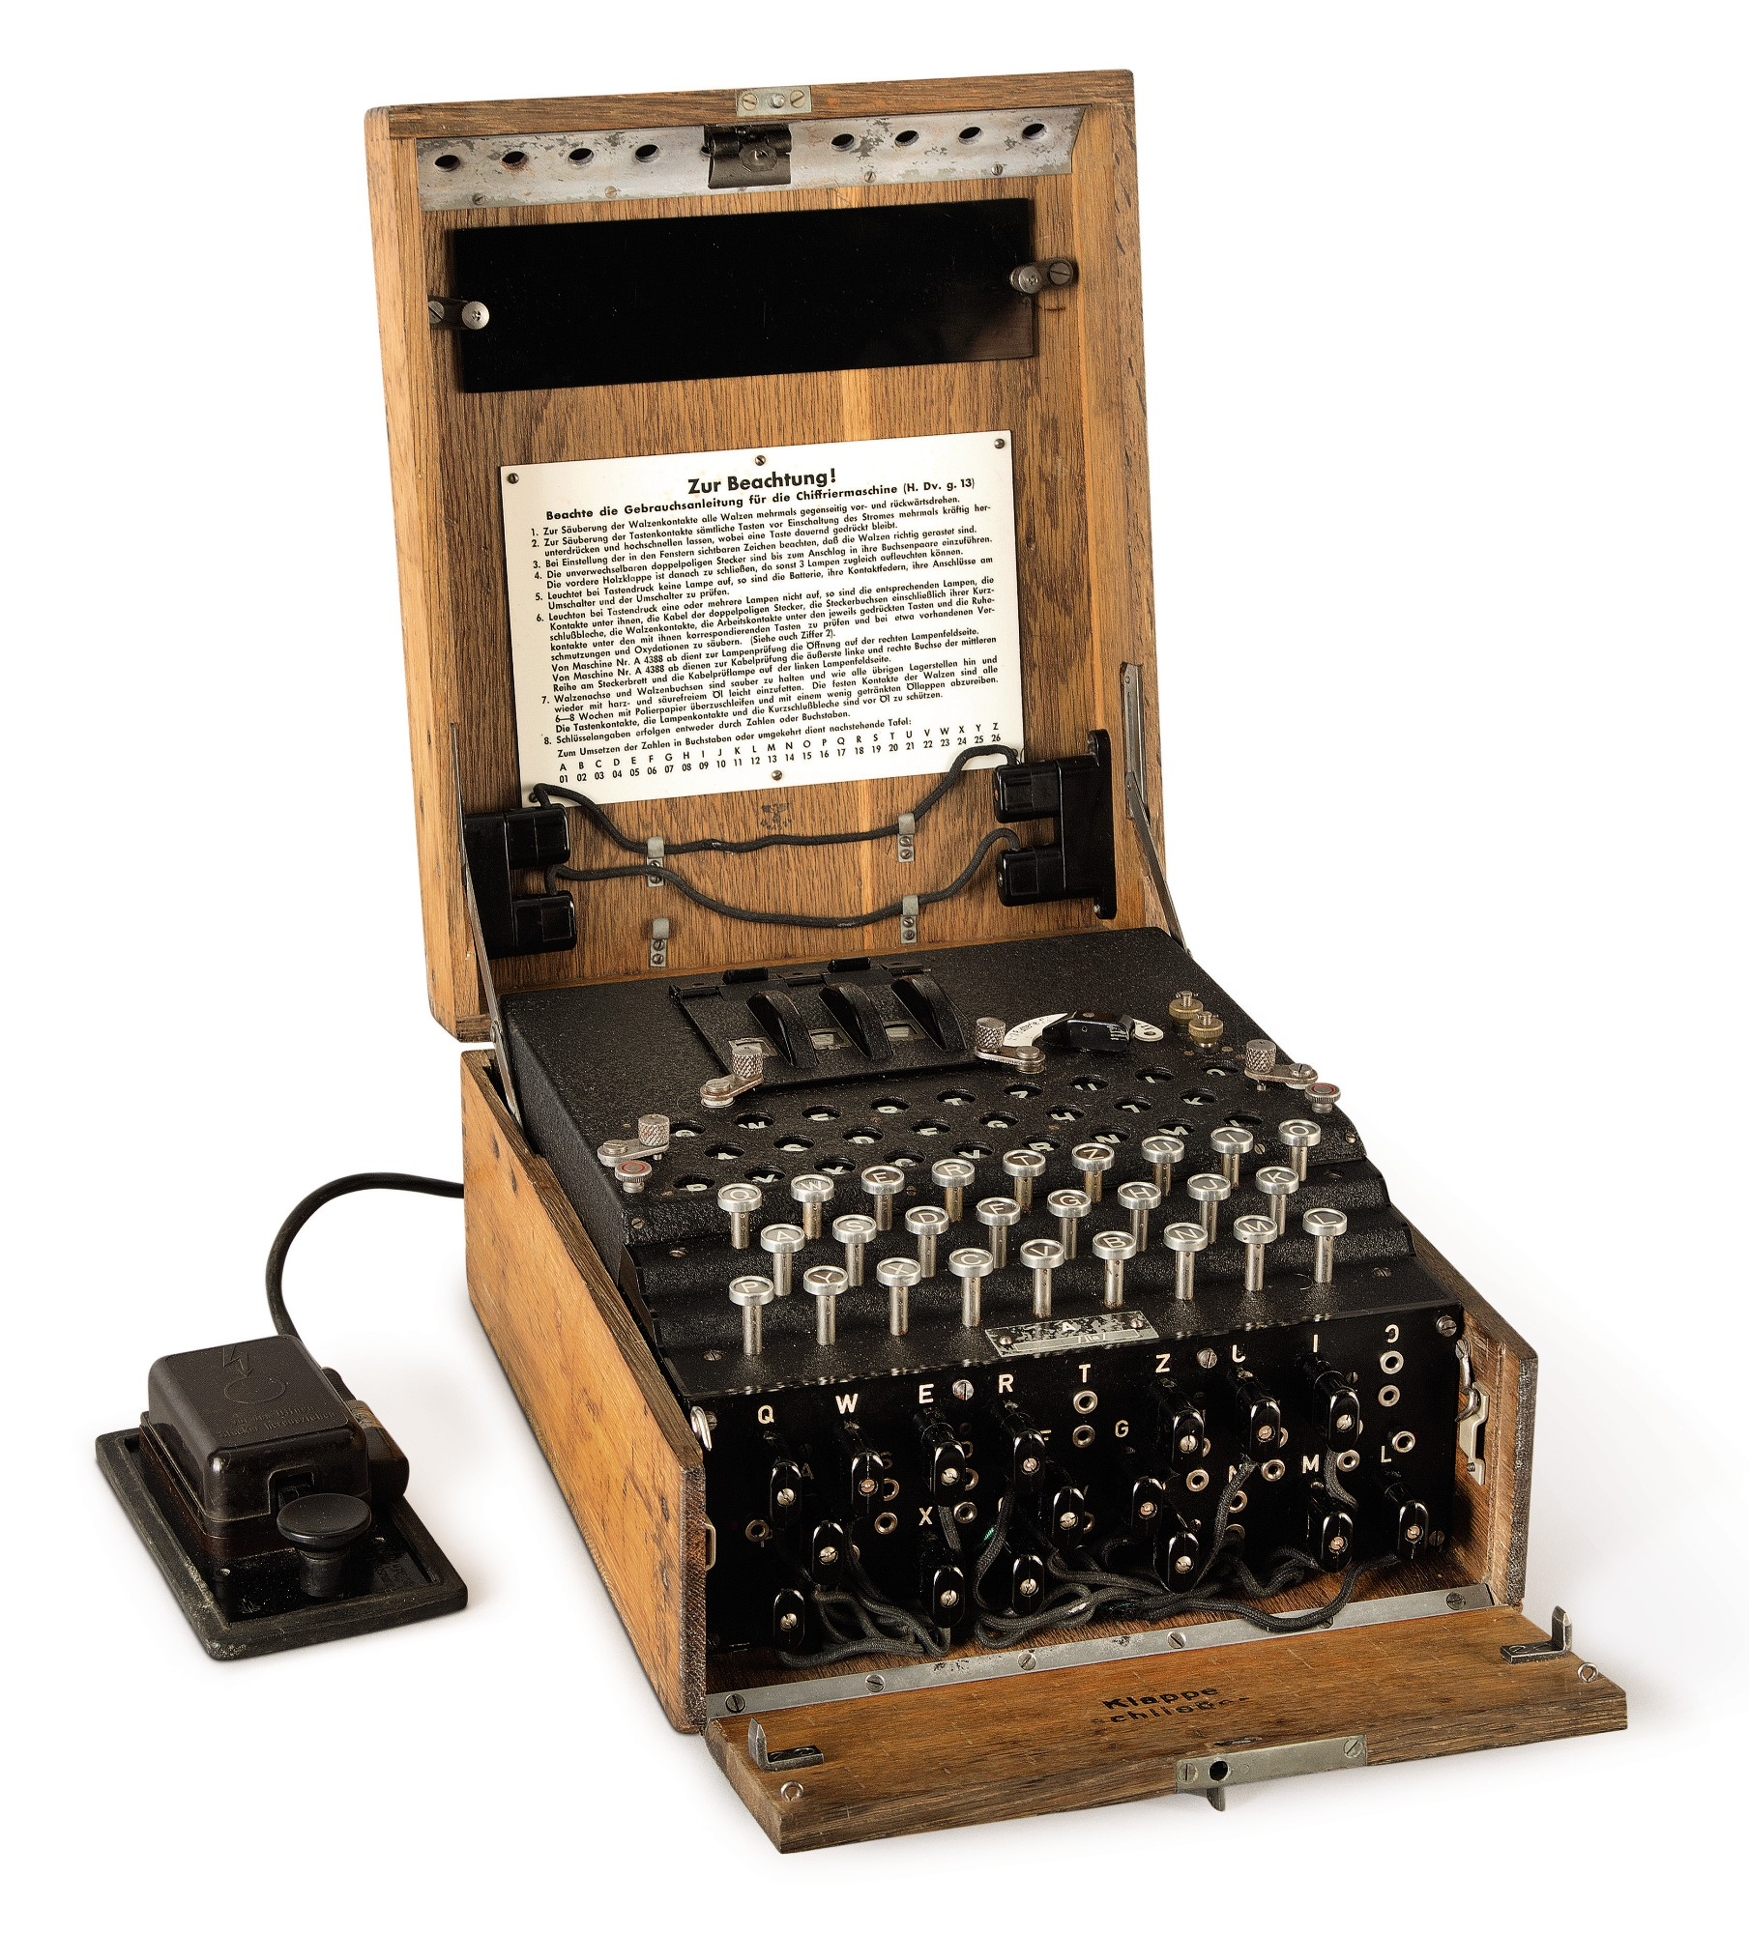
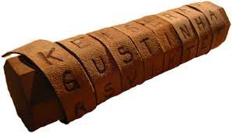
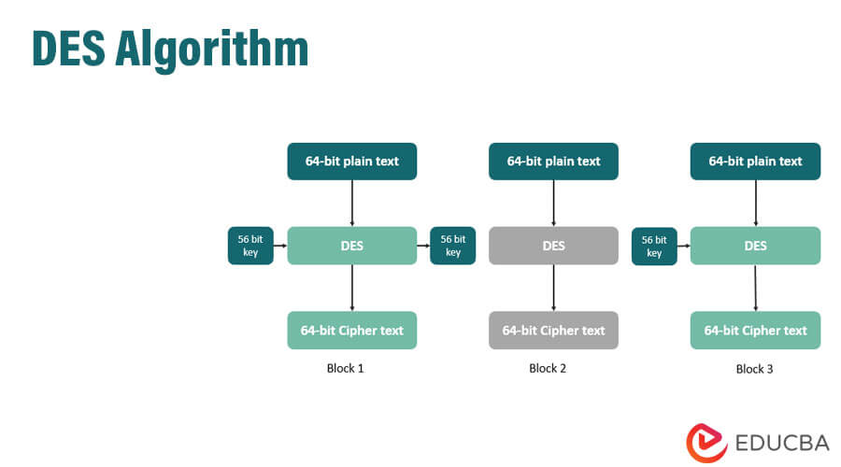
Cryptography in Engineering
Original Uses of Cryptography in Engineering
Originally used for military and war purposes by the Spartans.
Created the Scytale in 500 BCE
Al-Kindi, a mathematician and philosopher from Iraq, wrote the first known book on cryptography, "A Manuscript on Deciphering Cryptographic Messages," which laid the foundation for what is now modern-day cryptography.
Modern Uses in Engineering
World War II: The Enigma used by the Germans, which was an electromechanical cipher machine (1940)
The Data Encryption Standard, symmetric-key algorithm used for digital encryption, was adopted as a federal Standard (1977)
Scytale
Enigma

Slide 5
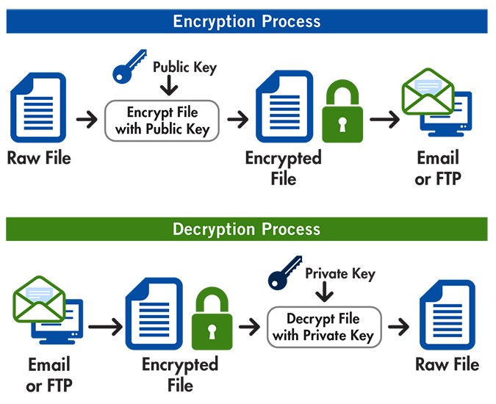
Cryptography in Engineering (Continued)
Importance of Cryptography
Protect intellectual property
File encryption: requires the correct decryption keys to be readable otherwise you cannot access the file
Ensure system integrity and privacy
Hash functions, provides ability to detect any unauthorized modifications to data.
Most common type of data encryption used is Advanced Encryption Standard (AES), a 256-bit encryption.
Secure Communication
A sender and a recipient must already have a shared key that is known to both
Both user authentication and message authentication to ensure that the message is unaltered

Slide 6
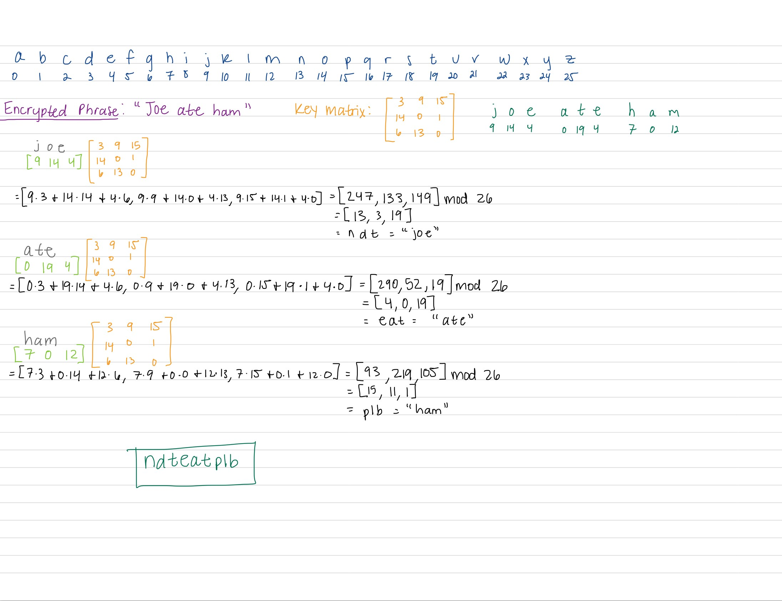

Encryption
(Hill Cipher)

Slide 7
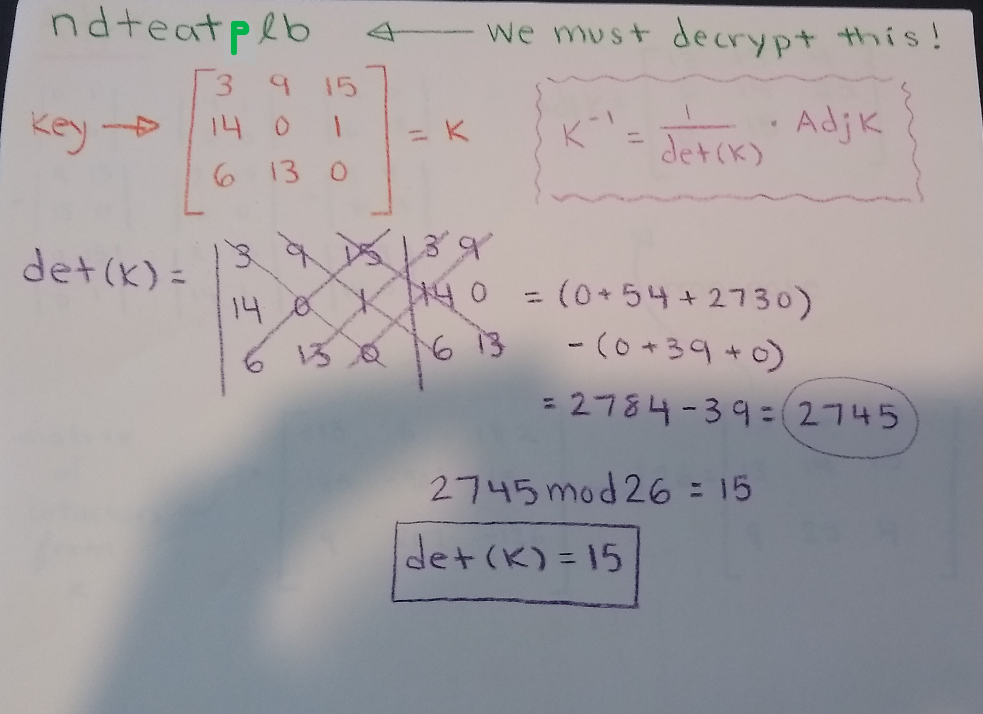
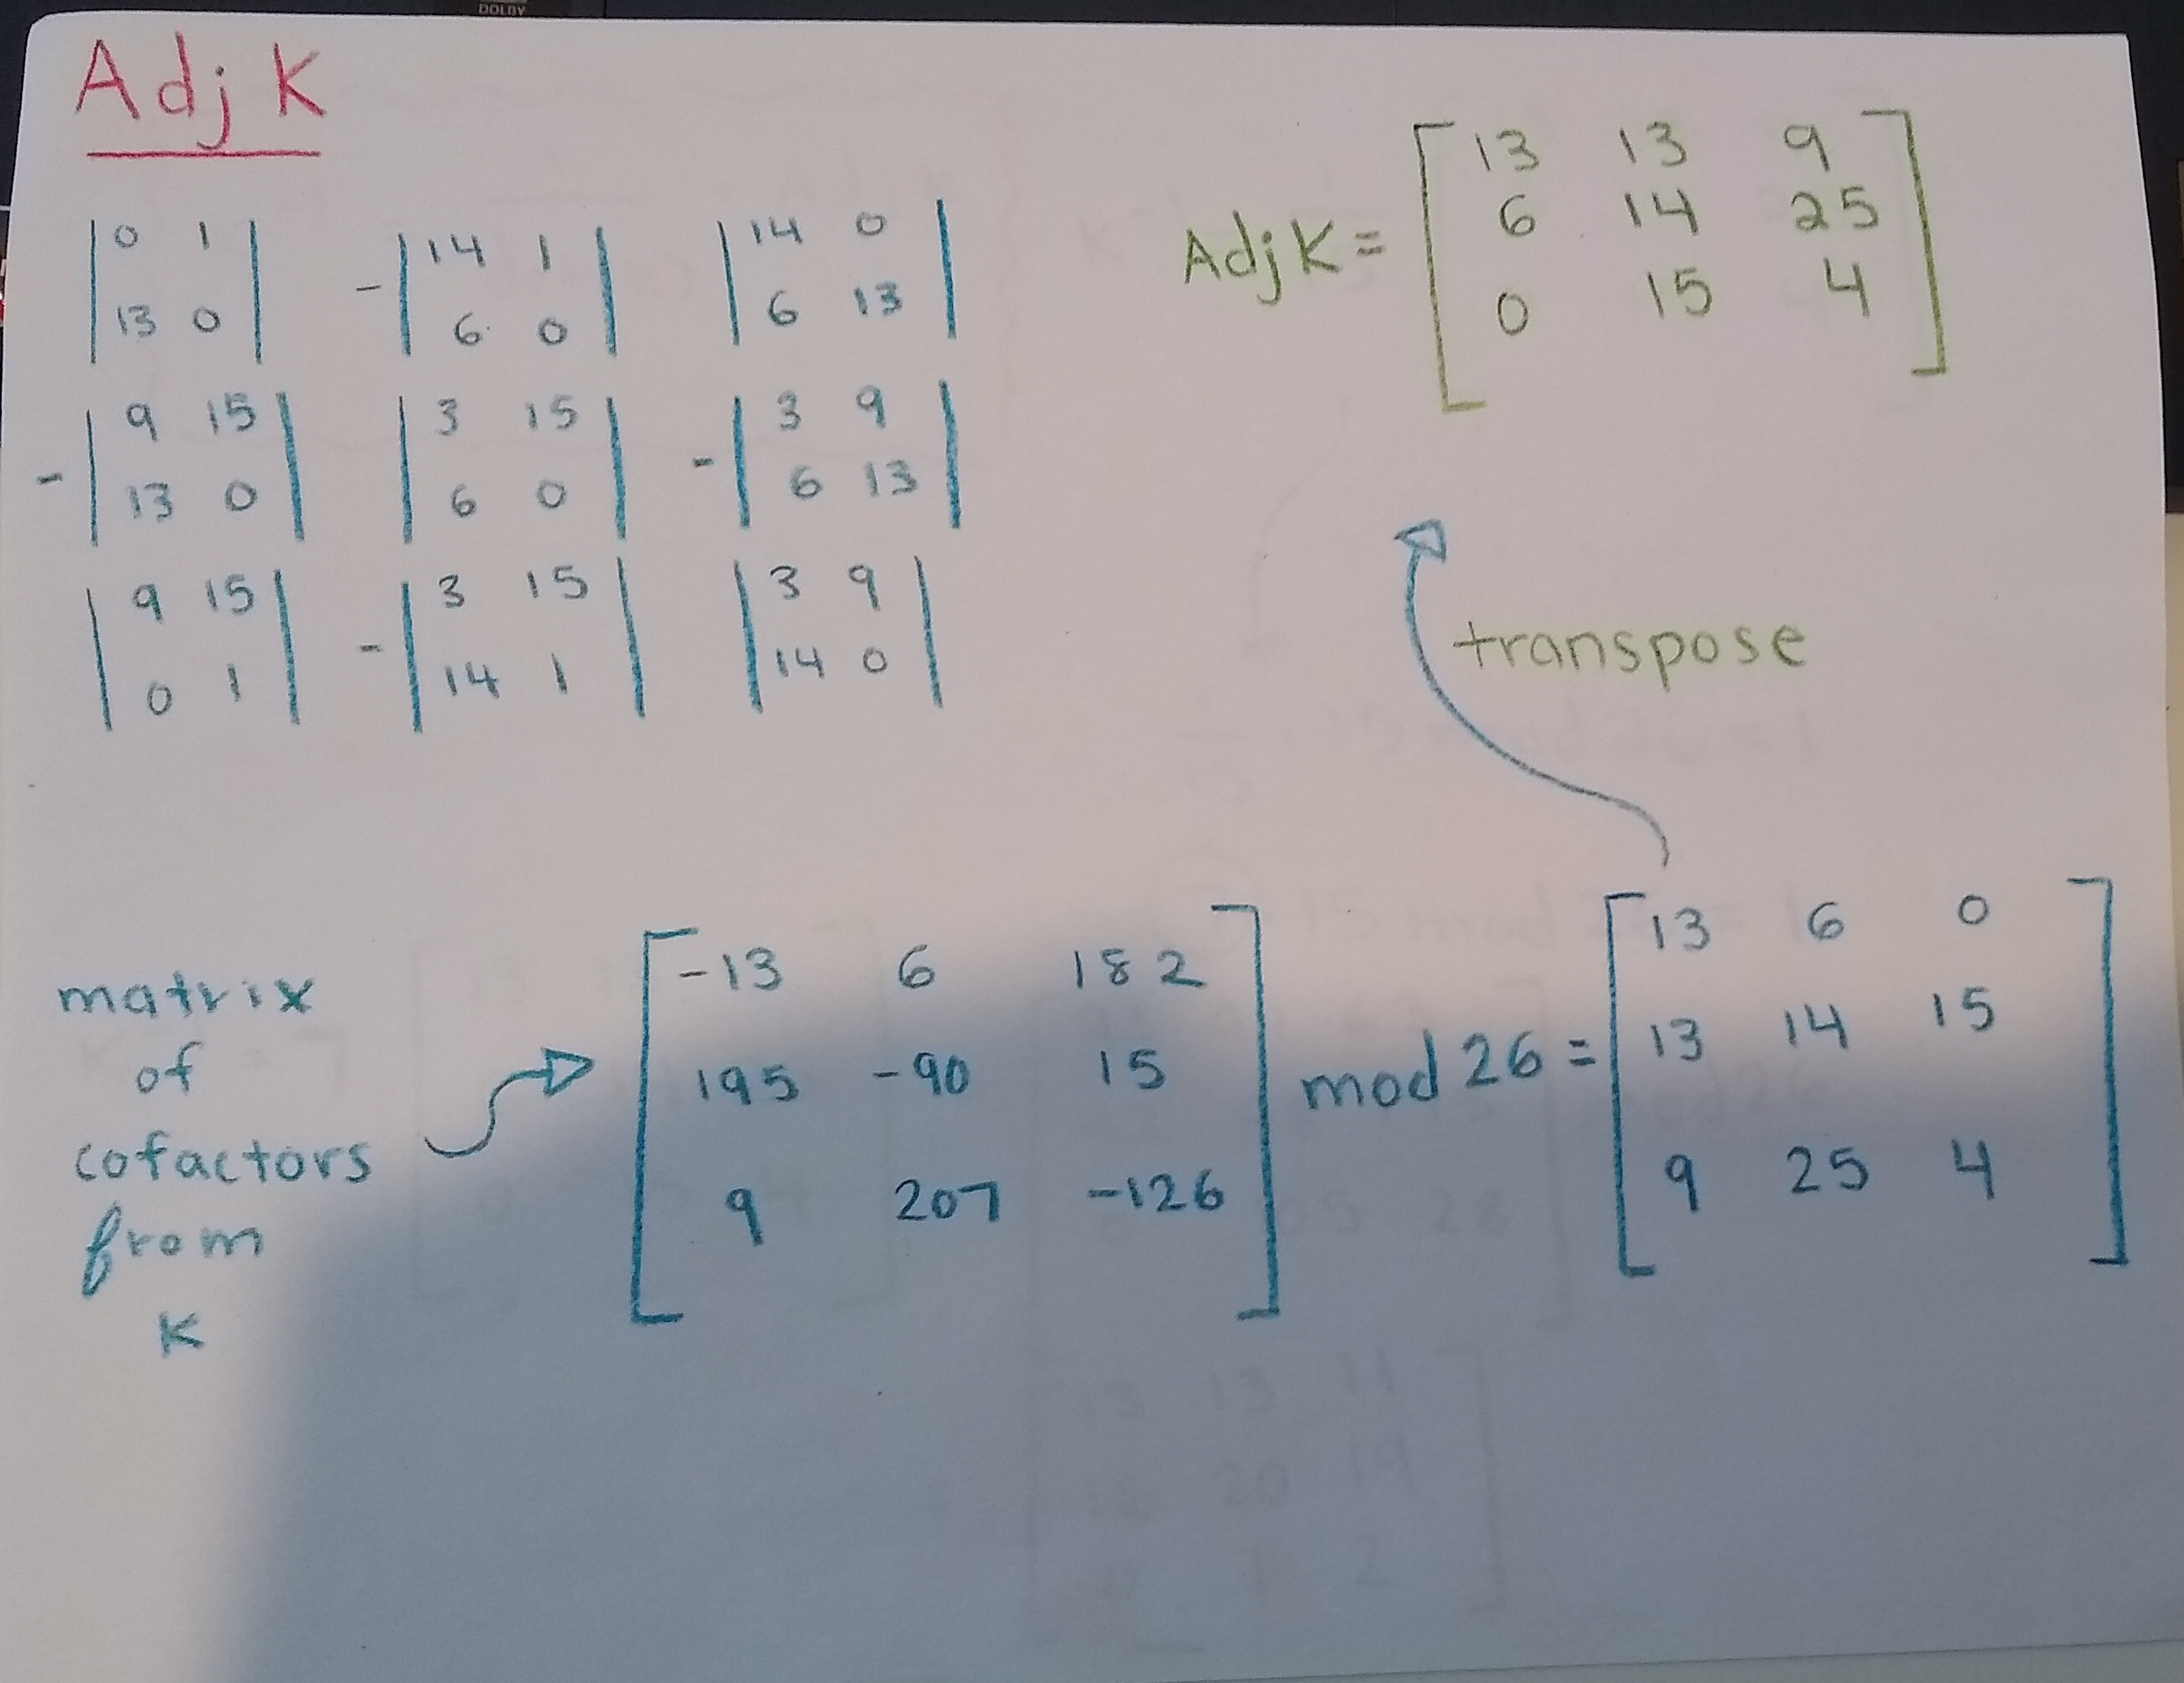
Decryption

Slide 8
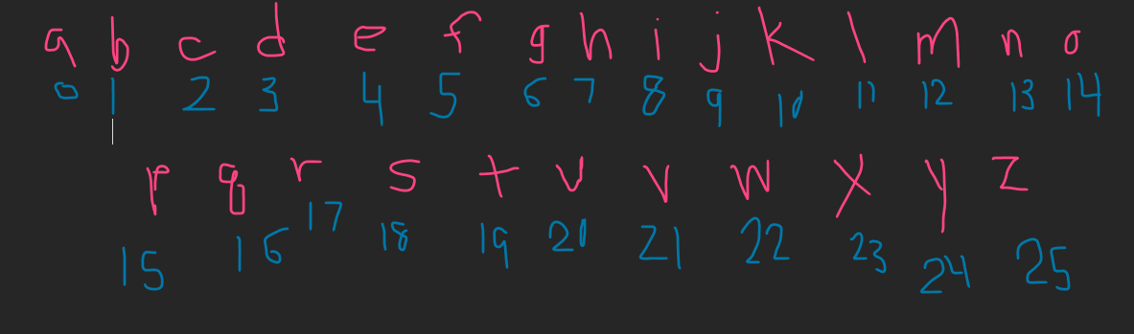
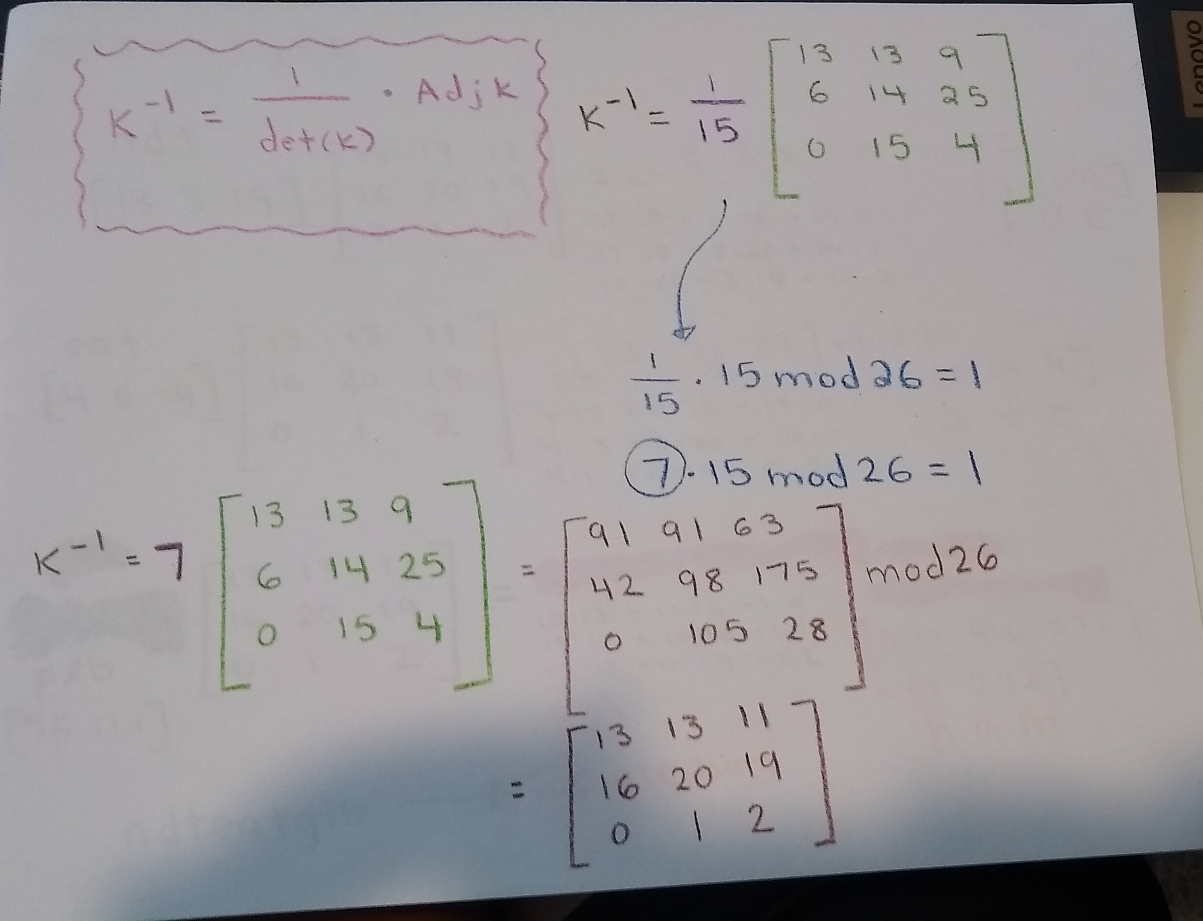
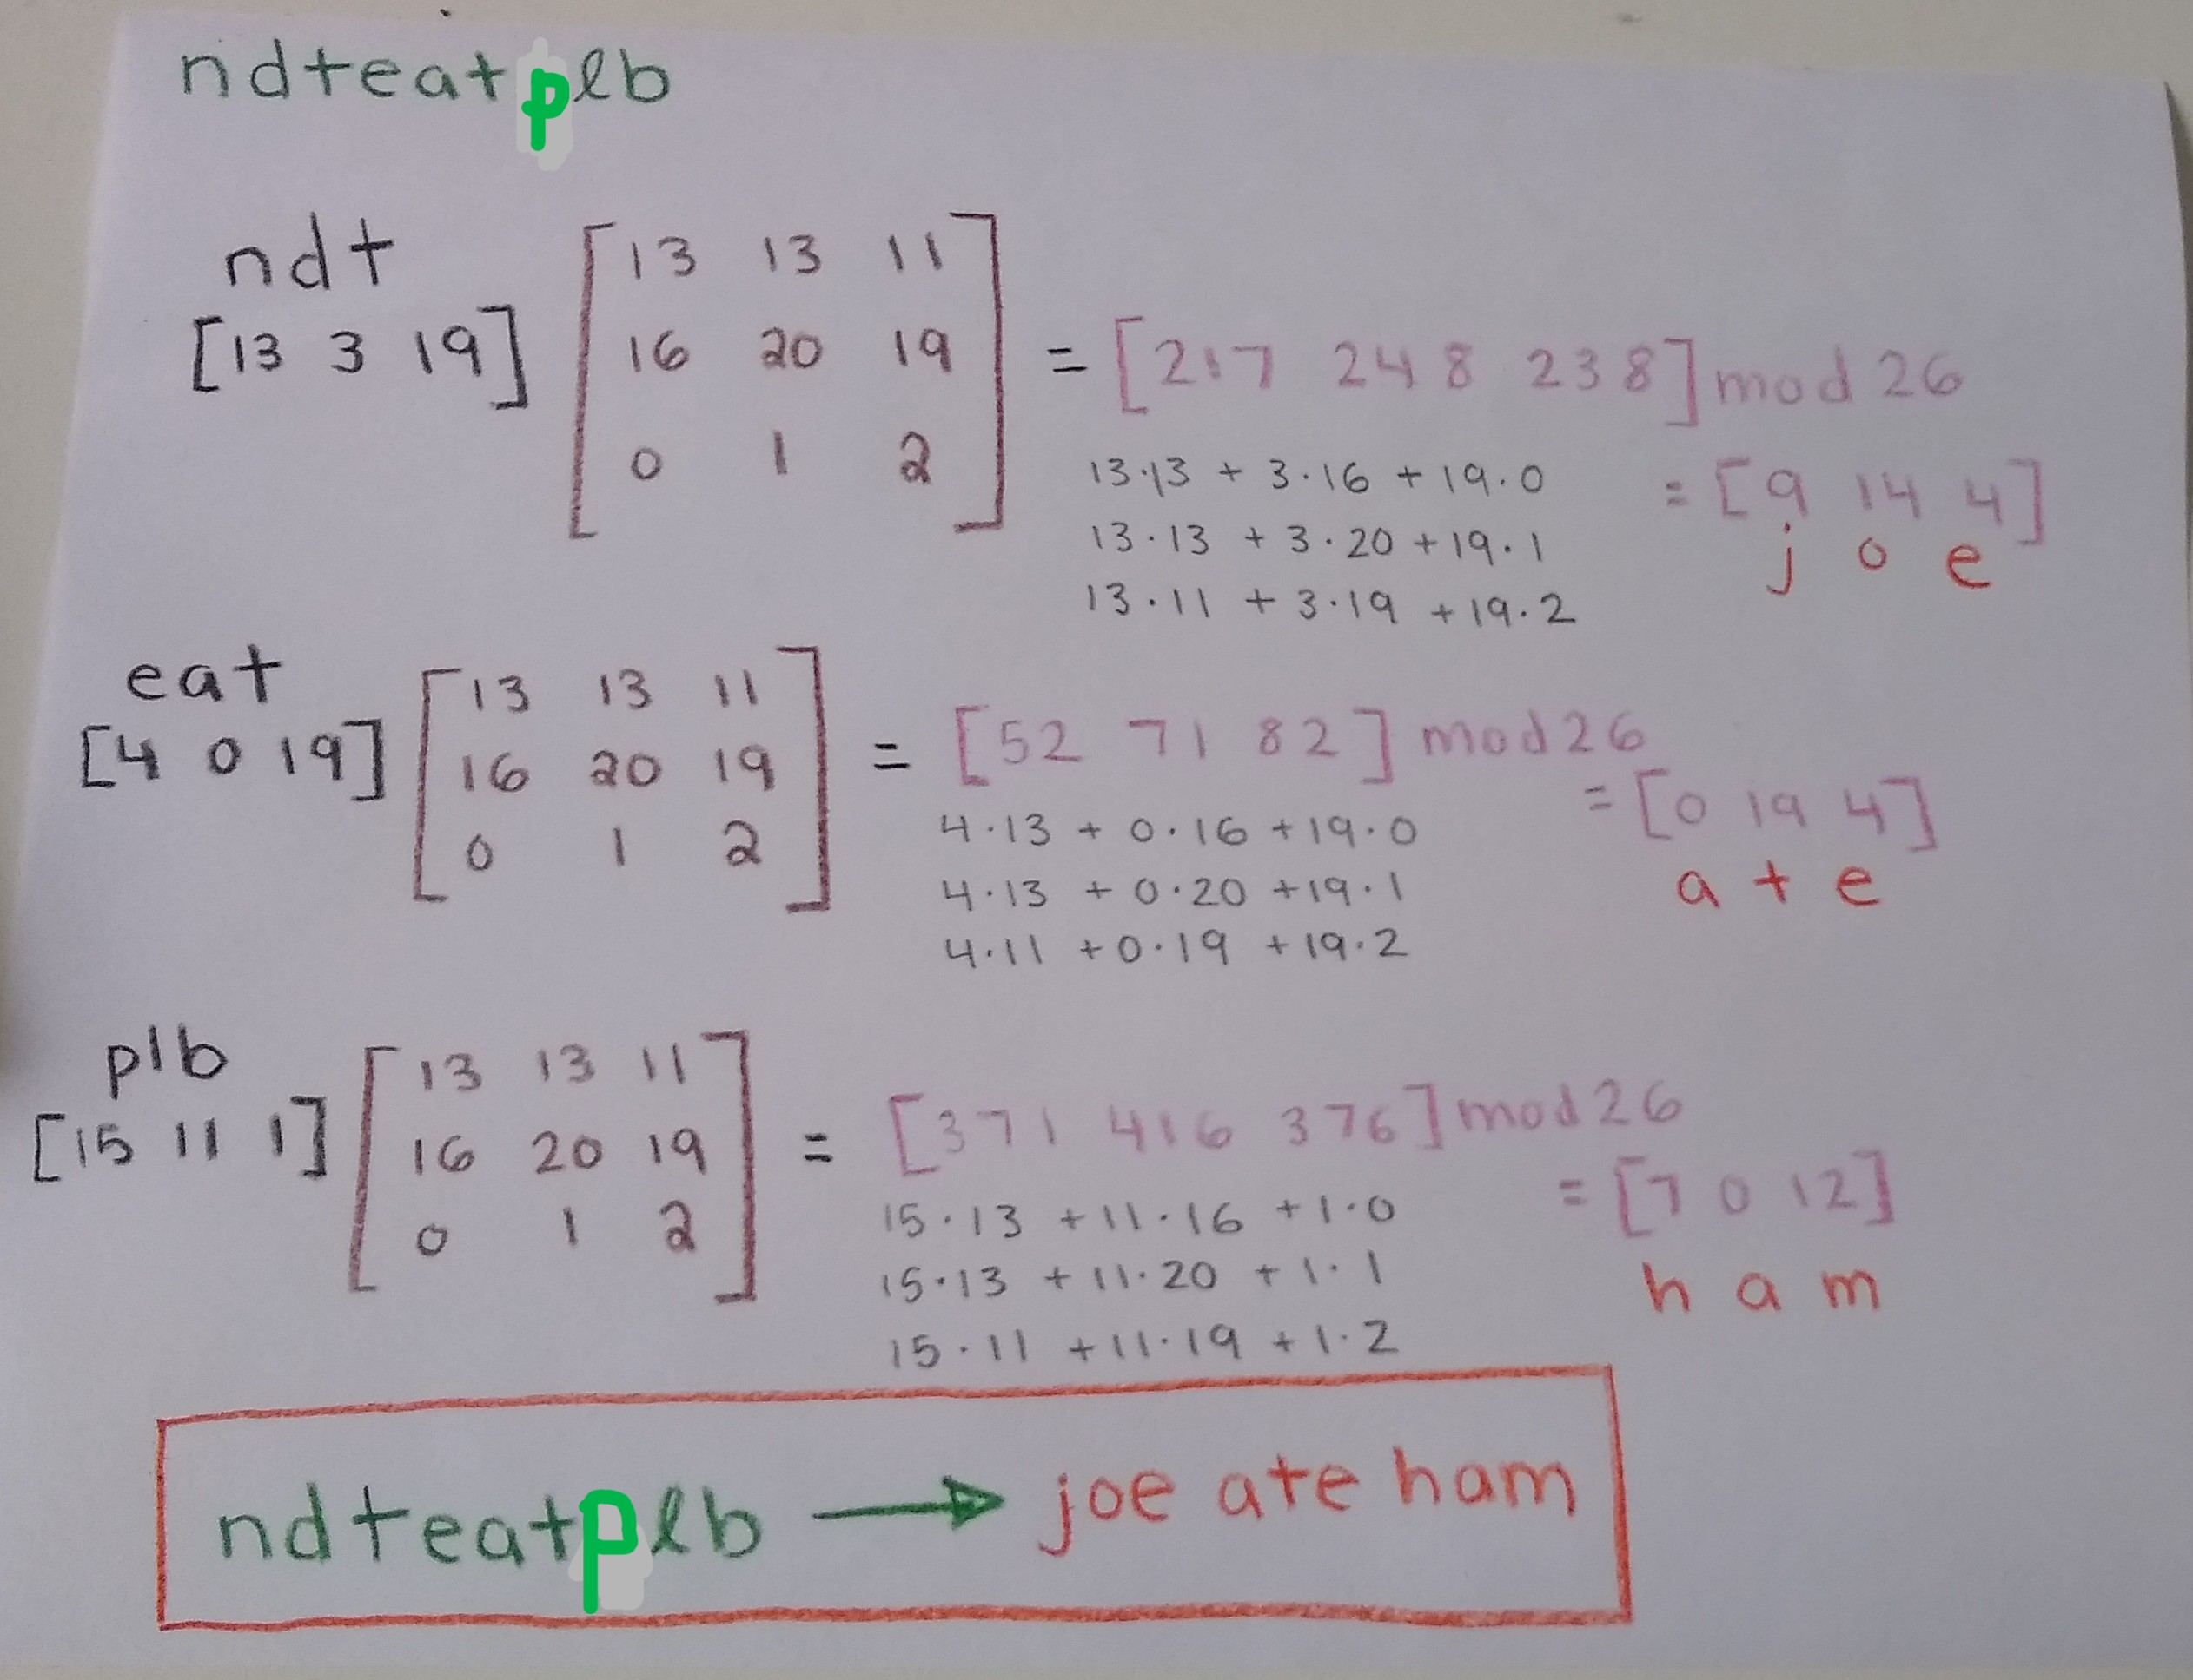

Slide 9
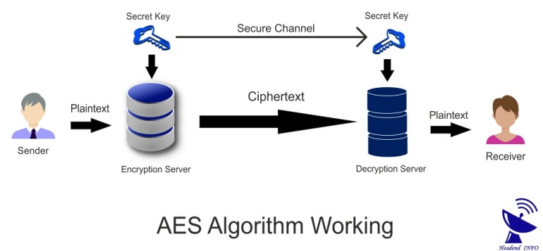
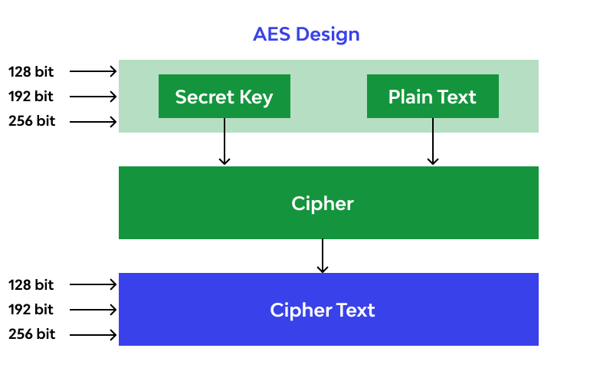
Modern Encryption
Up until the 1990s, Data Encryption Standard (DES) was being used until it was replaced by Advanced Encryption Standard (AES)
DES used a 56-bit key while AES uses a 128 bit-key
DES offers 72 quadrillion possible keys while AES offers 340 undecillion possible keys

Slide 10
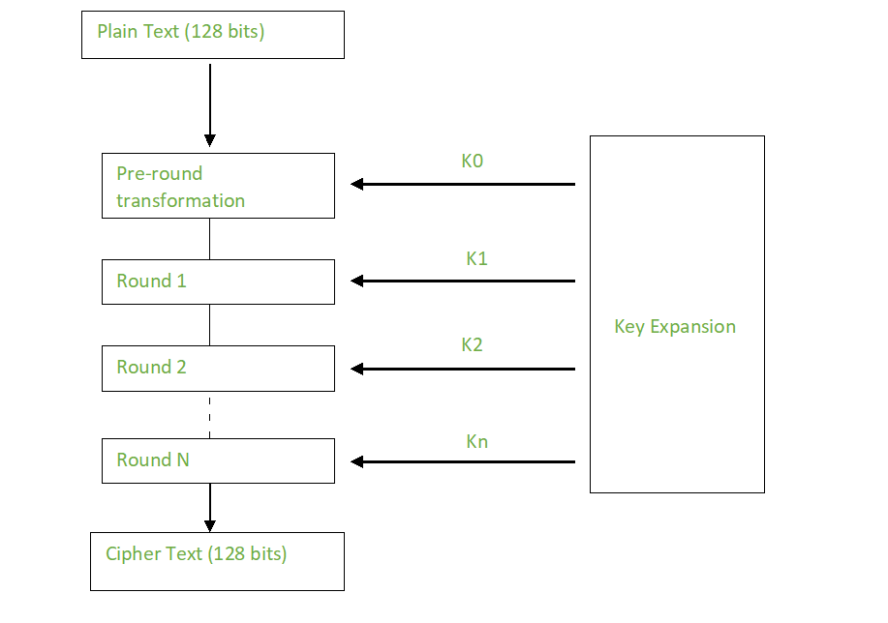
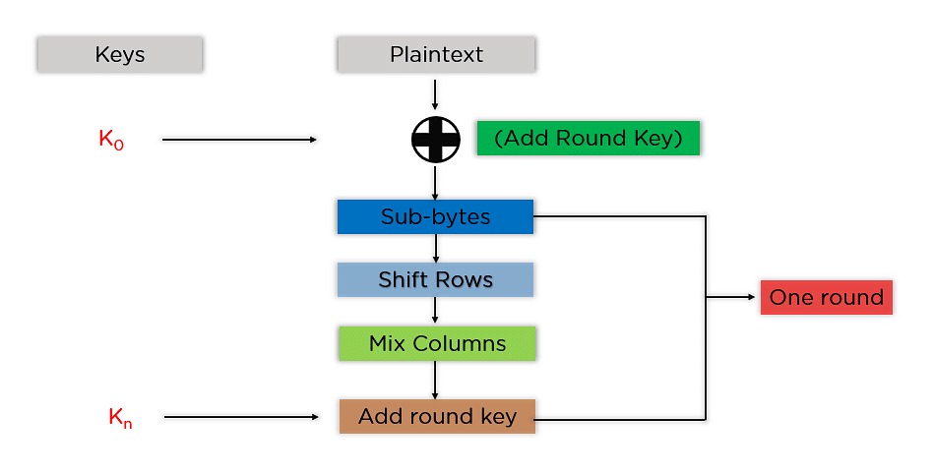

AES & Linear Algebra
Holistic Overview
Encryption Round Overview

Slide 11
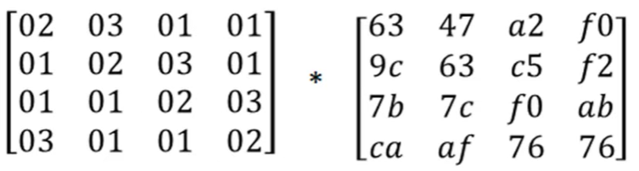

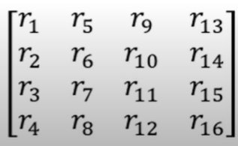
AES & Linear Algebra: Mix Columns
State Matrix (Data)
Mix Column Matrix
( Process repeated N times)
Cipher Matrix

Slide 12

Conclusion
Cryptography's evolution in a digitalized world
Foundation built on linear algebra
Secure engineering practices
Confidential and reliable communication

Slide 13
References
Al-Tayeb, T. (2003, June 9). Al-Kindi, Cryptography, Code Breaking and Ciphers. Muslim Heritage. https://muslimheritage.com/al-kindi-cryptography/
CalculatorSoup, L. (2023, October 20). Modulo calculator. https://www.calculatorsoup.com/calculators/math/modulo-calculator.php
Capelle, C. (2020, July 20). How to protect intellectual property with technology. CapLinked. https://www.caplinked.com/blog/how-to-protect-intellectual-property-with-technology/
Diepenbroek, M. (2022, January 22). Ancient cybersecurity? deciphering the spartan scytale. Antigone. https://antigonejournal.com/2021/06/deciphering-spartan-scytale/
Fatayer, T. (2020, June 10). Secure communication using cryptography and covert channel. IntechOpen. https://www.intechopen.com/chapters/64915
How will quantum technologies change cryptography?. Caltech Science Exchange. (n.d.). https://scienceexchange.caltech.edu/topics/quantum-science-explained/quantum-cryptography
Kabashi, F., Shkurti, L., Qehaja, B., Leka, H., & Selimaj, M. (2022). Using Matrices in Cryptography. UBT Knowledge Center, 7. https://knowledgecenter.ubt-uni.net/cgi/viewcontent.cgi?article=4220&context=conference#page=10

Slide 14
References
Sekhon, R., & Bloom, R. (2022, July 18). Application of Matrices in Cryptography. Mathematics LibreTexts. https://math.libretexts.org/Bookshelves/Applied_Mathematics/Applied_Finite_Mathematics_(Sekhon_and_Bloom)/02%3A_Matrices/2.05%3A_Application_of_Matrices_in_Cryptography
Simmons, G. J. (2023, October). Product ciphers. Encyclopædia Britannica. https://www.britannica.com/topic/cryptology/Product-ciphers
Thiruchelvi, M. (2014). Application of Linear Algebra in Cryptography. In International Conference on Information and Image Processing (ICIIP-2014). https://conference.bonfring.org/papers/sankara_iciip2014/iciip88.pdf
Wikimedia Foundation. (2023, September 13). Hill cipher. Wikipedia. https://en.wikipedia.org/wiki/Hill_cipher
YouTube. (2021). Hill Cipher (Encryption). YouTube. Retrieved November 26, 2023, from https://www.youtube.com/watch?si=PUN56nAFBLLTnSY-&v=-EQ8UomTrAQ&feature=youtu.be.
YouTube. (2021). Hill Cipher (Decryption). YouTube. Retrieved November 26, 2023, from https://www.youtube.com/watch?si=MC2sVIFXJ0MTd2bS&v=JK3ur6W4rvw&feature=youtu.be.

